Slide 1




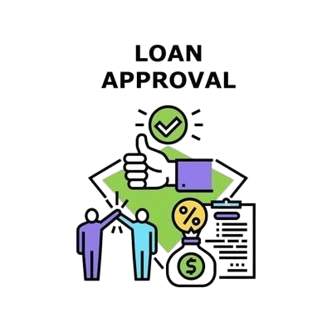


BANK LOAN REPORT

Slide 2
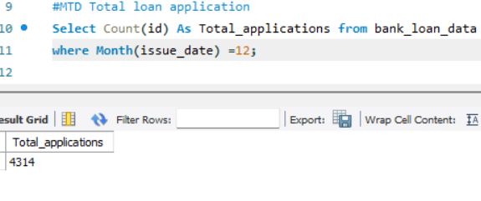
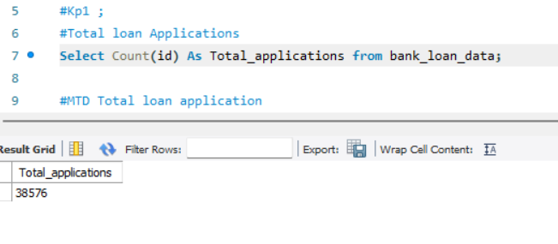
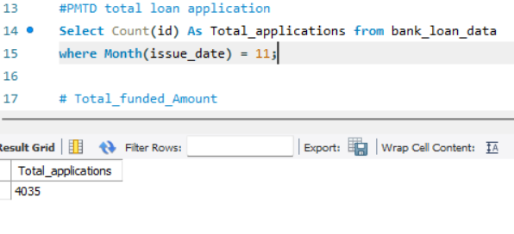
TOTAL LOAN Application by Month-to-date
KPI’S :
1. TOTAL LOAN APPLICATION :
Total Loan Application By Previous Month-to-date

Slide 3
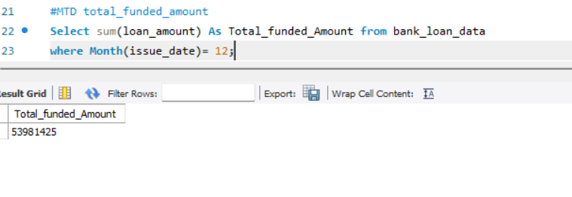
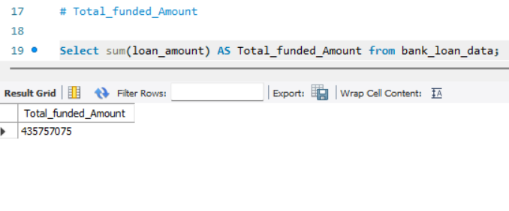
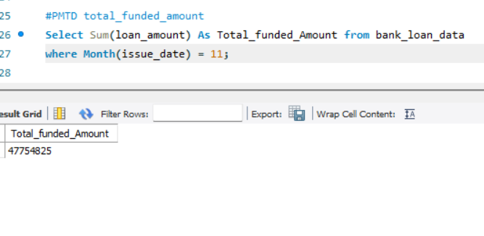
TOTAL_Funded_Amount by Month-to-date
2.Total_Funded_Amount :
Total_funded_Amount By Previous Month-to-date

Slide 4
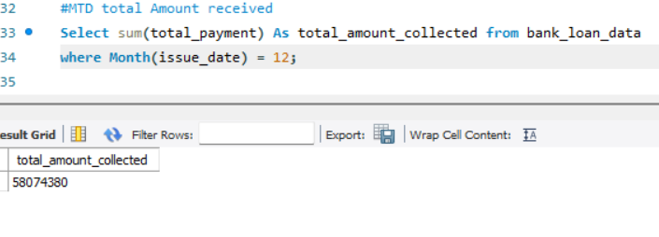
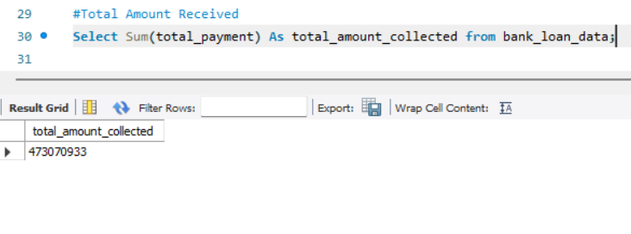
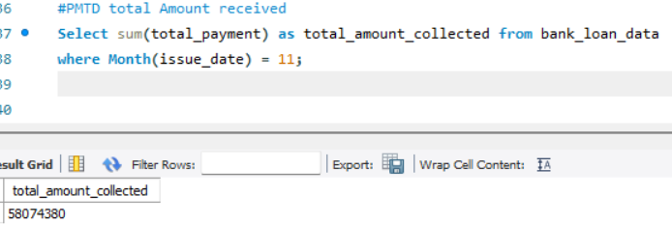
Total_Amount_Received by Month-to-Date
3.Total_Amount_Received:
Total_Amount_Received by Previous Month-to-Date

Slide 5
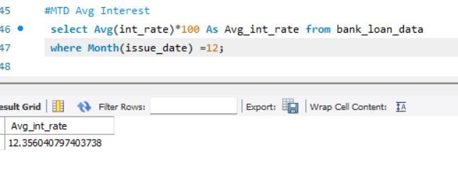
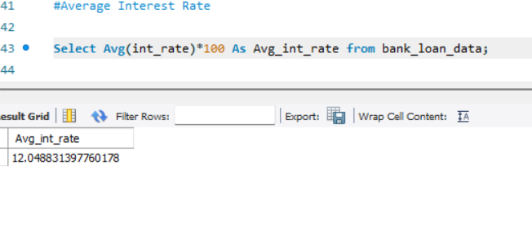
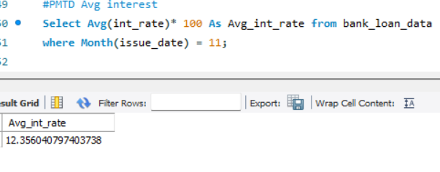
Month-To-Date Average Interest:
4. Average_Interest_Rate :
Previous Month-To-Date Average Interest:

Slide 6
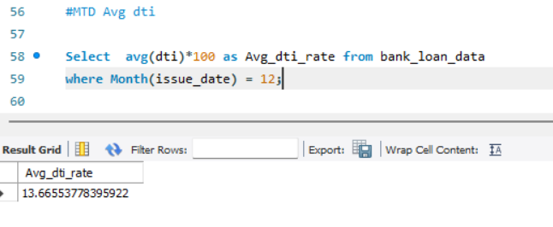
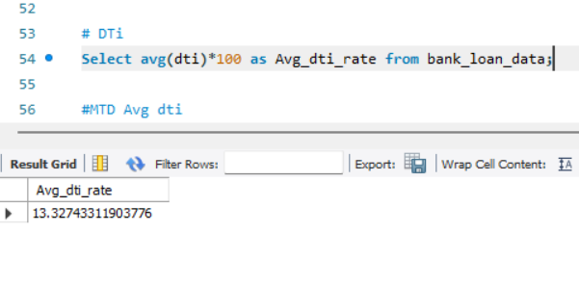
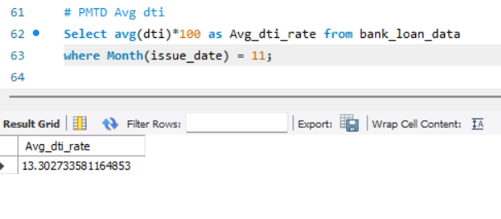
Month-To-Date DTI:
5.Debt-to-income ratio (DTI):
Previous Month-To-Date DTI:

Slide 7
Queries chart :
Good loan issued:
Good loan percentage
Good loan Application
Good loan Funded amount
Good loan Amount Recevied

Slide 8
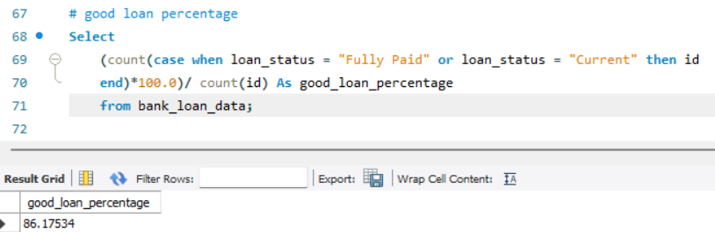
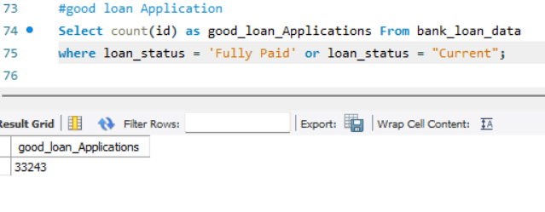
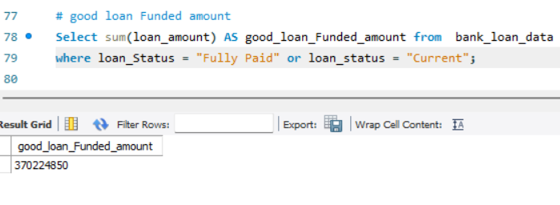
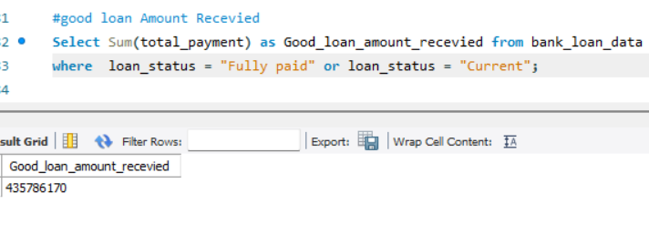
Good loan percentage:
Good loan Application
Good loan Funded amount
Good loan Amount Recevied

Slide 9
Queries chart :
Bad loan issued:
Bad loan percentage
Bad loan application
Bad loan Funded amount
Bad loan Amount Recevied

Slide 10
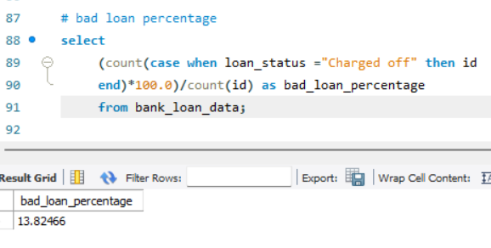
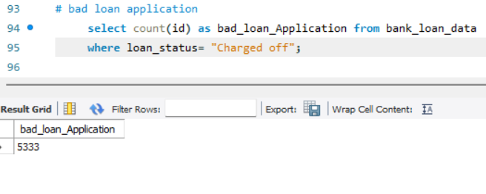
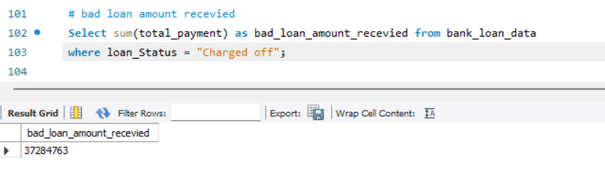
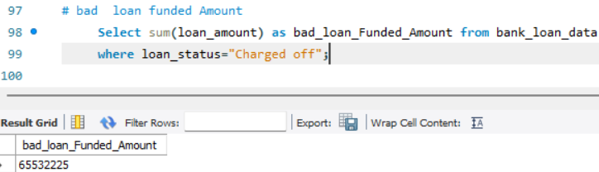
Bad loan percentage:
Bad loan Application :
Bad loan Funded amount:
Bad loan Amount Recevied

Slide 11
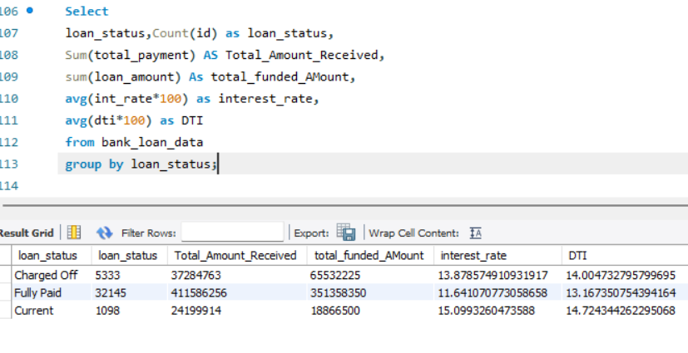
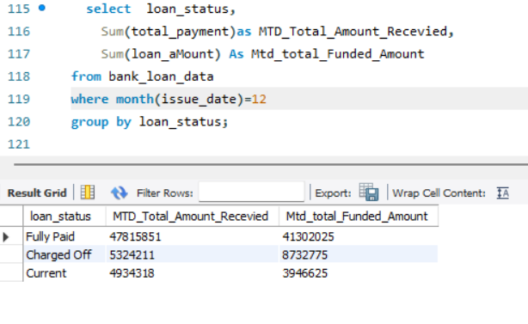
Summary BY Loan Status:
Summary BY MTD Loan Status:

Slide 12
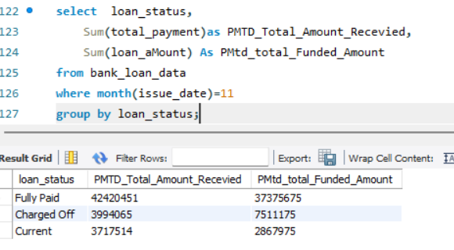
Summary BY PMTD Loan Status :

Slide 13
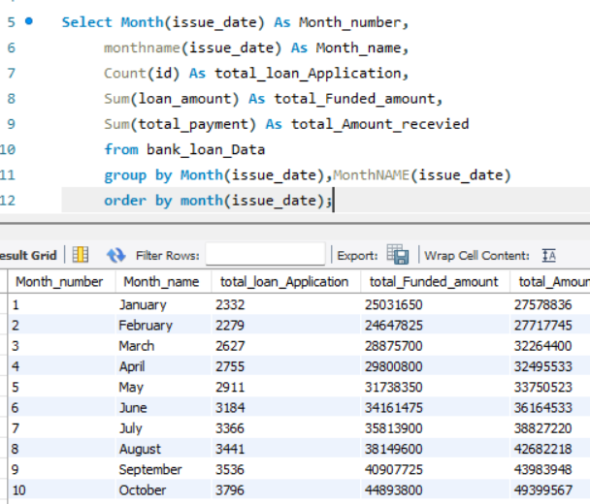
OverView :
BY MONTH :

Slide 14
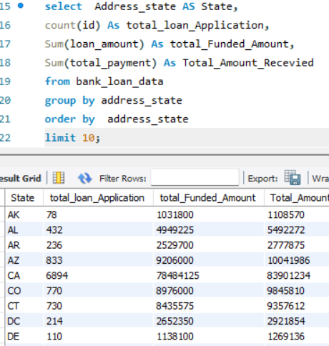
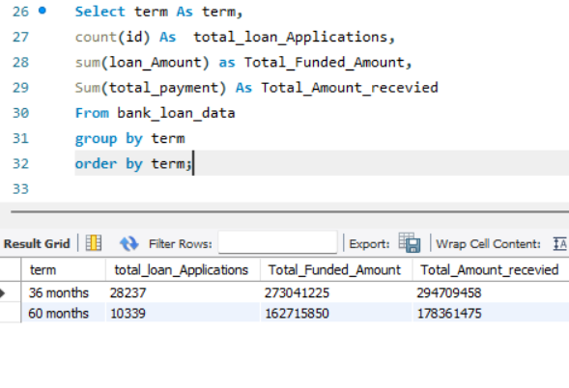
2.By State :
3.BY TERM :

Slide 15
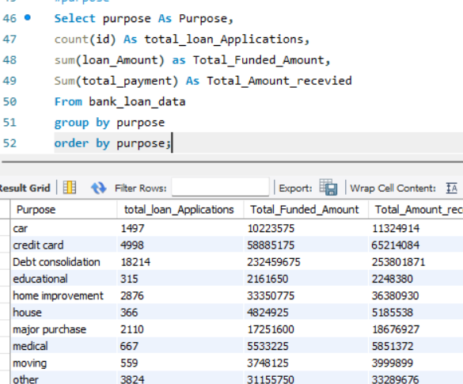
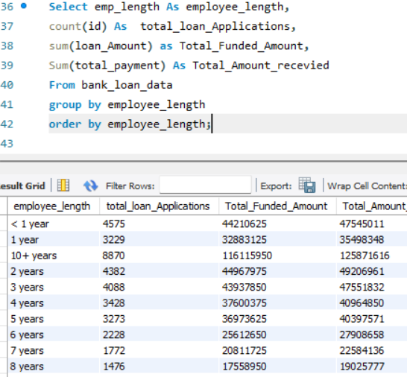
5.BY PURPOSE :
4.BY EMPLOYEE LENGTH :

Slide 16
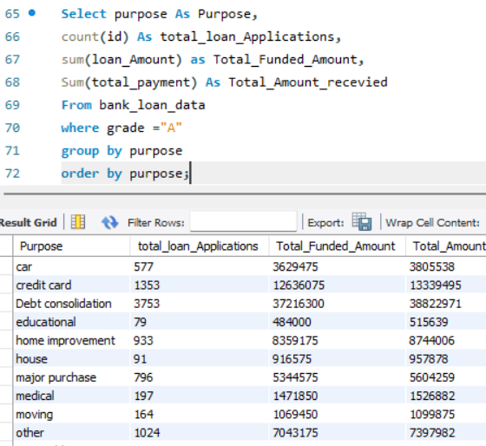
6. PURPOSE BY GRADE :

